Slide 1
CIRCUIT THEORY INITIAL VALUE AND FINAL VALUE THEOREM
Declaration : The content of the presentation has been created for academic use / non-commercial use with fair dealing.

Slide 2
SYED HASAN SAEED
Email
hasansaeedcontrol@gmail.com
URL
http://shasansaeed.yolasite.com/
http://hasansaeed872726549.wordpress.com/
http://syedhasansaeed.gnomio.com/

Slide 3
REFERENCE BOOKS
Introductory Circuit Analysis, Robert L. Boylested, Pearson Education, Prentice Hall.
Networks And Systems, Ashfaq Husain, Khanna Book Publishing Co (P) Ltd. Delhi.
Networks And Systems, A Sudhakar, Shyammohan S Palli, Tata McGraw Hill, New Delhi.
Network Analysis, M.E. Van Valkenburg, PHI Learning Private limited, New Delhi.
Circuit Analysis Principle and Applications, Allan H. Robbins &Wilhelm C. Miller, DELMAR CENGAGE Learning, Indian Reprint.

Slide 4
INITIAL VALUE AND FINAL VALUE THEOREM
The initial value theorem is useful in determining the initial value of function f(t) and final value theorem is used to determine the final value of function f(t).
INITIAL VALUE THEOREM:
The initial value theorem states that if f(t) and its derivative f’(t) are Laplace transformable, then the initial value f(0) of the solution f(t) is given by

Slide 5
INITIAL VALUE AND FINAL VALUE THEOREM
FINAL VALUE THEOREM:
The final value theorem states that if f(t) and its derivative f’(t) are Laplace transformable, then the final value f(∞) of the solution f(t) is given by
EXAMPLE 1: The response transform of series RL circuit is given by
Find the initial value of the time response using initial value theorem.

Slide 6
INITIAL VALUE AND FINAL VALUE THEOREM
SOLUTION:
By initial value theorem
EXAMPLE 2: Find the initial value using initial value theorem.

Slide 7
INITIAL VALUE AND FINAL VALUE THEOREM
SOLUTION:

Slide 8
INITIAL VALUE AND FINAL VALUE THEOREM
EXAMPLE 3: For the current
i₂(t) = 5u(t) – 3e^{-2t}
Find the final value by using final value theorem.
SOLUTION: Take Laplace transform of the given function

Slide 9

INITIAL VALUE AND FINAL VALUE THEOREM
EXAMPLE 4: Find the final value and initial value of f(t) = 3 + 2e^{-t} by using final value and initial value theorem.
SOLUTION: Take Laplace transform of the given function
$\text{F} ( \text{s} ) = \frac{3}{s}\text{ − }\frac{2}{\text{s} + \text{1}} = \frac{\text{3} \text{s} + \text{3} \text{+} \text{2} \text{s}}{\text{s} ( \text{s} + \text{1} )}$ = $\frac{\text{5} \text{s} + \text{3} }{\text{s} ( \text{s} + \text{1} )}$
$$\text{Apply} \text{final} \text{value} \text{the}or\text{em}$$
$$\text{f} \left(∞\right)=\underset{\text{t} →∞}{\text{Lim}} \text{I} \left( \text{t} \right) = \underset{\text{s} →0}{\text{Lim}} \text{s} \text{F} \left( \text{s} \right)$$
$$= \underset{\text{s} →0}{\text{Lim}} \text{s}\text{. }\frac{\text{5} \text{s} + \text{3}}{\text{s} ( \text{s}+\text{1} )} = \frac{\text{3}}{1} = \text{3}$$
Reference: Network Analysis & Synthesis by Uday Bakshi & Ajay Bakshi, Technical Publications Pune

Slide 10

INITIAL VALUE AND FINAL VALUE THEOREM
SOLUTION: Given function is
$\text{F} ( \text{s} )=\frac{\text{5} \text{s} + \text{3} }{\text{s} ( \text{s} + \text{1} )}$
$$\text{Apply} \text{initial} \text{value} \text{the}or\text{em}$$
$$\text{f} \left(0\right)=\underset{\text{t} →0}{\text{Lim}} \text{f} \left( \text{t} \right) = \underset{\text{s} →ꝏ}{\text{Lim}} \text{s} \text{F} \left( \text{s} \right)$$
$= \underset{\text{s} →ꝏ}{\text{Lim}} \text{s}\text{. }\frac{\text{5} \text{s} + \text{3}}{\text{s} ( \text{s}+\text{1} )} =$ $\underset{\text{s} →ꝏ}{\text{Lim}}\frac{\text{5} \text{s} + \text{3}}{ ( \text{s}+\text{1} )}$ = $\underset{\text{s} →ꝏ}{\text{Lim}}\frac{5+\frac{3}{s}}{1 + \frac{1}{s}}$ = 5
Reference: Network Analysis & Synthesis by Uday Bakshi & Ajay Bakshi, Technical Publications Pune

Slide 11
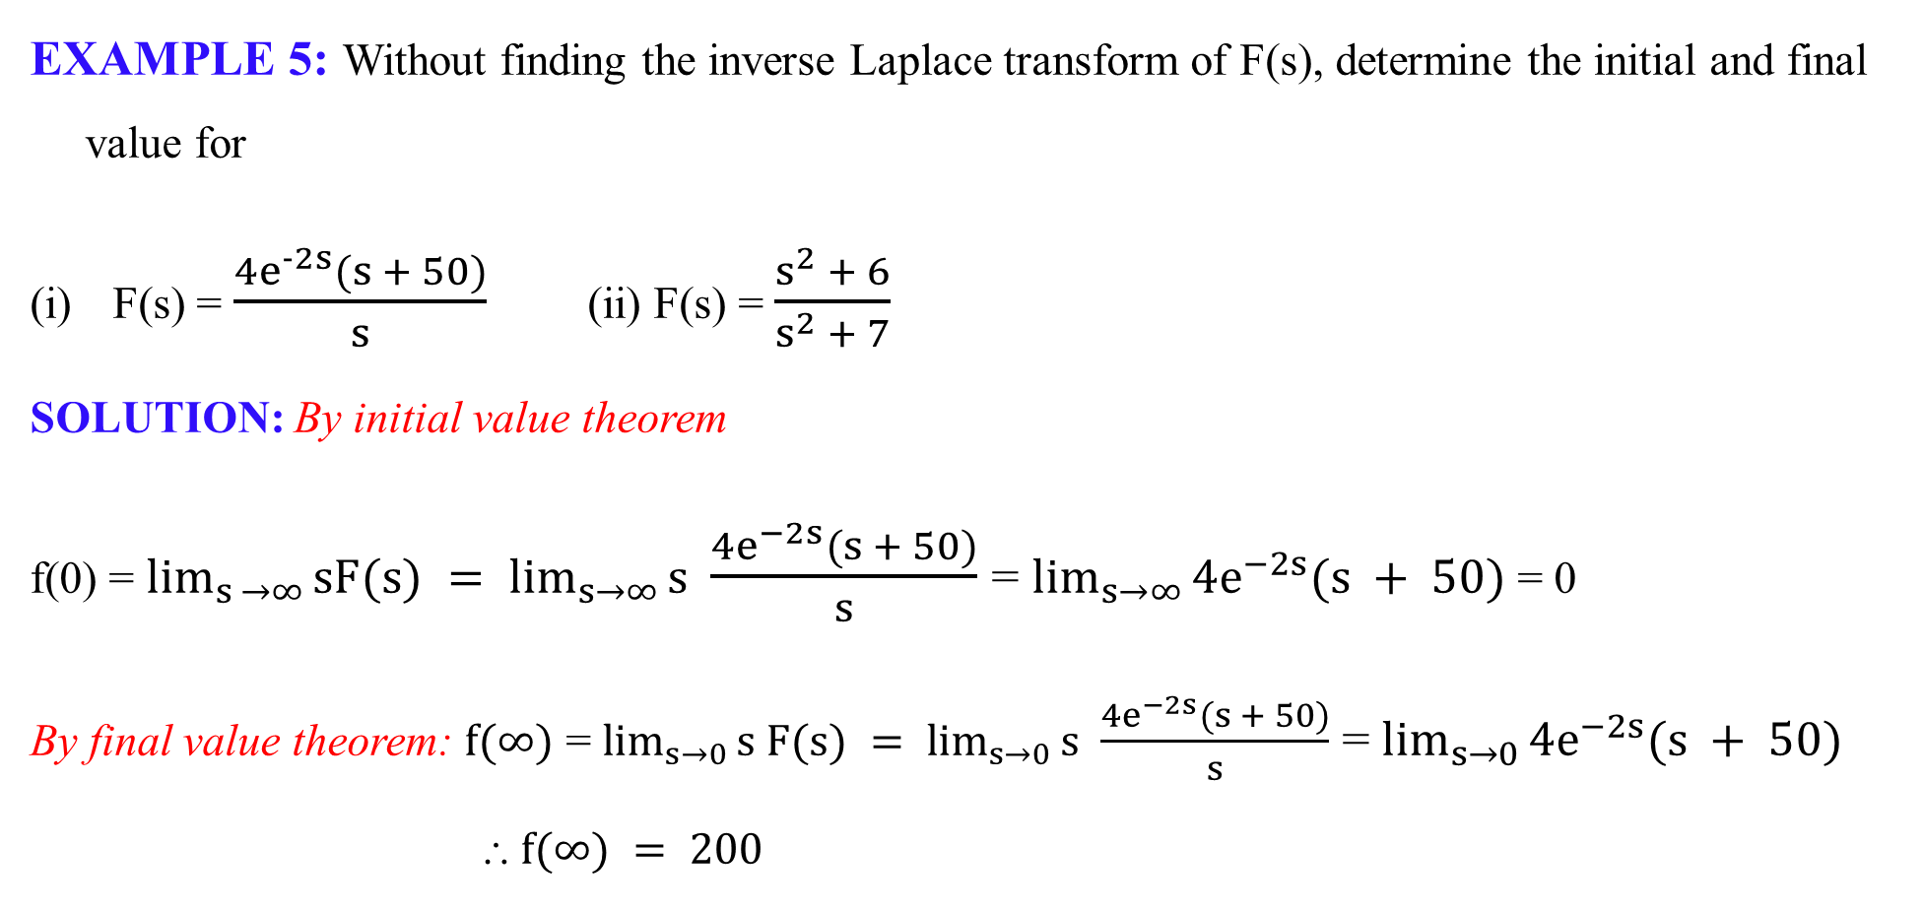
INITIAL VALUE AND FINAL VALUE THEOREM
EXAMPLE 5: Without finding the inverse Laplace transform of F(s), determine the initial and final value for
F(s) = $\frac{4e^{−2s}(s + 50)}{s}$ (ii) F(s) = $\frac{s^{2} + 6}{s^{2} + 7}$
SOLUTION: By initial value theorem
f(0) = $\lim_{s →∞}{sF(s) = \lim_{s→∞}{s }}$ $\frac{4e^{−2s}(s + 50)}{s}$ = $\lim_{s→∞}{4e^{−2s}(s + 50)}$ = 0
By final value theorem: $f(∞)$ = $\lim_{s→0}{s F(s) = \lim_{s→0}{s }}$ $\frac{4e^{−2s}(s + 50)}{s}$ = $\lim_{s→0}{4e^{−2s}(s + 50)}$
⸫ $f(∞) = 200$
Reference: Network Analysis & Synthesis by Uday Bakshi & Ajay Bakshi, Technical Publications Pune

Slide 12

INITIAL VALUE AND FINAL VALUE THEOREM
(ii) F(s) = $\frac{s^{2} + 6}{s^{2} + 7}$
SOLUTION: By initial value theorem
f(0) = $\lim_{s →∞}{sF(s) = \lim_{s→∞}{s }}$ $\frac{s^{2} + 6}{s^{2} + 7}$ = $\lim_{s→∞}{\frac{s^{3} + 6s}{s^{2} + 7}}$ = ꝏ
By final value theorem: $f(∞)$ = $\lim_{s→0}{s F(s) = \lim_{s→0}{s }}$ $\frac{s^{2} + 6}{s^{2} + 7}$= $\lim_{s→∞}{\frac{{s(s}^{2} + 6)}{s^{2} + 7}}$ = 0
⸫ $f(∞) = 0$
However, before accepting this result, check the poles of $sF\left(s\right)$: s2 + 7 = 0
s = ± j√7
Reference: Network Analysis & Synthesis by Uday Bakshi & Ajay Bakshi, Technical Publications Pune

Slide 13
INITIAL VALUE AND FINAL VALUE THEOREM
These poles lie on the imaginary axis, so the Final Value Theorem cannot be applied because the signal does not settle to a finite steady-state value.
Final Value Theorem is not applicable since sF(s) has poles at s = ± j√7
Therefore, f(∞) does not exist.
Reference: Network Analysis & Synthesis by Uday Bakshi & Ajay Bakshi, Technical Publications Pune

Slide 14

INITIAL VALUE AND FINAL VALUE THEOREM
FOR PRACTICE: DO YOURSELF
Without finding inverse Laplace transform of F(s), find the initial and final value.
F(s) = $\frac{5 s^{3} - 1600}{5 (s^{3}+ 18s^{2}+ 90s + 800)}$
Answer: initial value = 5 and final value = - 2

Slide 15
THANK YOU
shasansaeed@yolasite.com
hasansaeed872726549.wordpress.com
saeed.moodlecloud.com
syedhasansaeed.gnomio.com

